Slide 1

Premium Prediction & Risk Assessment Project
Using machine learning

Slide 2
“Data-driven insights are the lifeblood of modern insurance—transforming risk into foresight and uncertainty into opportunity.”
Thomas h. davenport

Slide 3


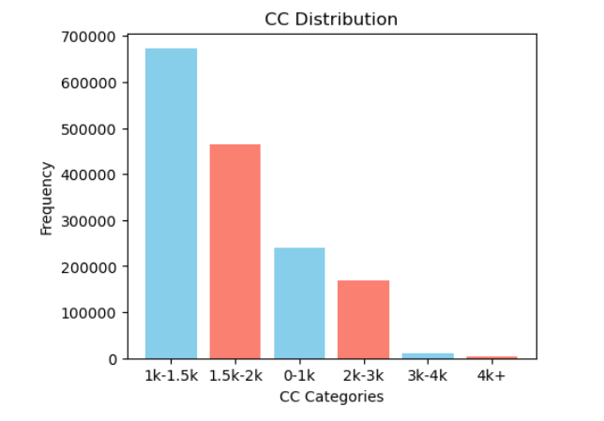


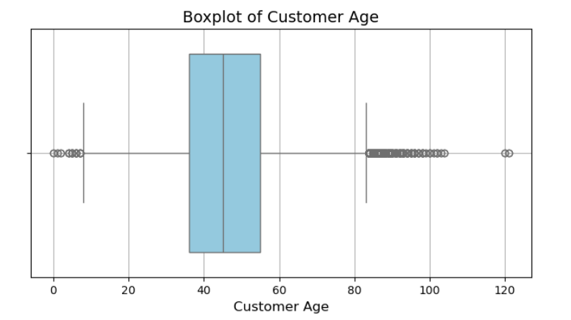
Enhancing Risk Assessment with Predictive Modeling
STEP
2
STEP4
STEP
4
Data Gathering
Worked with 2 million records of private car comprehensive data (2020-2024)
Exploratory Data
Analysis
data cleaning and visualization to uncover valuable insights
Data
Preprocessing
STEP
3
STEP
1
Data Transformation
Data
2072235 records
117 feature
Handled missing values
Handled outliers
Duplicate data
Normal distribution
Dealing with categorical data, Imbalanced data
-Dimension reduction
-Feature engineering

Slide 4
Enhancing Risk Assessment with Predictive Modeling
Model Building
Feature Importance comparison across various models
XGBoost Algorithm
Train data - 1559434 records
Test data – 166065 records
XGBoost
1) Customer age
CatBoost
no. of claims
Logistic Regression
no. of claims
2) Split
3) Ncb percentage
4) Customer age
5) Pre segment
6) Make
7) Vehicle age
8) CC
9) Customer gender
2) Post code
3) Vehicle age
4) Make
5) No. of claims
6) Ncb percentage
7) Year
8) Cc
9) Split
split
cc
ncb percentage
vehicle age
post code
Pre segment
customer gender
make
5 fold cross validation
Hyperparameter Tuning
Boost round- 1000
Max Depth- 10
Learning rate – 0.05
Regularization -1
Backtesting

Slide 5


Risk Assessment Results: Model Performance Overview
Actual | Predicted
 |  | Low LR(0) | High LR(1)
 | Low LR(0) | 161815 | 234
 | High LR(1) | 97 | 3919
Supervised Classification
XGBoost Model Matrix
Precision | 94%
Recall | 97%
F1 score | 95%

Slide 6
To give you an Overview,

Slide 7
Premium Pricing Prediction
Data Understanding & Cleaning
Exploratory analysis
Model Development
Hyperparameter Tuning & Optimization
Testing and Generalization
Problem Statement:
Predicting motor insurance premiums based on claim costs using market data.
Drop less significant features
CC Bins
Grouping of records
Concatenation of Policy & Claim data
Data Selected:
Private Comprehensive Motor Policy Insurance of Malaysia (PIB)
5 years (2020-24)
Policy data:
Records = 1,601,765 , Features = 21
Claim data:
Records = 60,541 , Features = 21
Grouping records in terms of [policy_no, inception_date, expiry_date, split]

Slide 8
Premium Pricing Prediction
Data Understanding & Cleaning
Exploratory analysis
Model Development
Hyperparameter Tuning & Optimization
Testing and Generalization
Outlier Detection
Missing Data imputation
Drop features & records
Include Loss Ratio
Model: CATBOOST Regressor
Identify categorical columns by their indices, extract them separately, and remove them from the numerical features.
Training data: 2020-22
Test Data: 2023 & 2024
Iterations: 900
Train fit: 84.9%
Test (2023) fit: 84.12%
Test (2024) fit: 81.2%

Slide 9
Overview: for High-Risk records

